Slide 1
The Effects on the Psychological Well-Being of BSSW Working Students at Dalubhasaan ng Lungsod ng Lucena; Coping Strategies and Challenges in Academic and Part-Time Work
MARANAN, KRISTEL GAILE
MUNDIN, ELIZABETH

Slide 2
Panel’s comments and actions taken
PANEL MEMBER | COMMENTS/ RECOMMENDATIONS | ACTION TAKEN
MA’AM LIZA | Add the challenges experienced by working students. | Challenges were included in the study, can be seen in Title and Objectives of the study. Page. 3
MA’AM LIZA | Include 1st year students in the participants. | Participants were revised to 1st–3rd year BSSW students Page. 6
MA’AM LIZA | Present the Research Instrument in paragraph form. | The Research Instrument was rewritten in paragraph form, pages. 29
MA’AM LIZA & MA’AM ARNIGO | Use a mixed-method approach instead of purely qualitative research. | The research design was revised to a mixed-method approach. Page. 28

Slide 3
Panel’s comments and actions taken
PANEL MEMBER | COMMENTS/ RECOMMENDATIONS | ACTION TAKEN

Slide 4
CHAPTER 1 – Brief introduction
Many college students work while studying to support their financial needs and families. Although part-time work provides income and valuable experience, balancing academic and work responsibilities can create stress and affect students' psychological well-being. Working students often face challenges such as time pressure, heavy workloads, and limited support. Therefore, effective coping strategies are important in helping them manage stress, maintain their well-being, and succeed in both their studies and work.

Slide 5
Theoretical Framework
Bandura's theory explains that students' psychological well-being is influenced by the interaction of their personal factors, environment, and behaviors. For working students, these include their thoughts and emotions, academic and work demands, and the coping strategies they use.
Lazarus and Folkman's theory explains how students assess stressful situations and choose ways to cope with them. These coping strategies may include time management, seeking support, and self-care practices.
Together, these theories help explain how BSSW working students manage academic and work-related challenges while maintaining their psychological well-being.

Slide 6
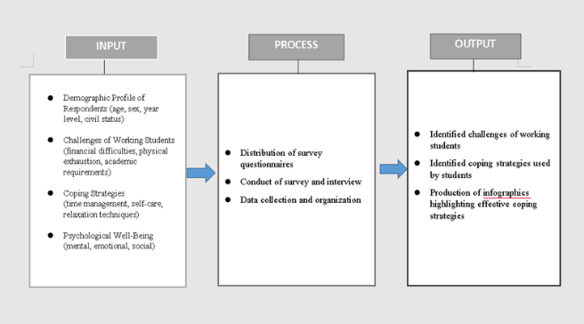
Research Paradigm

Slide 7
Scope and Limitation
SCOPE
This study focuses on the psychological well-being, challenges, and coping strategies of BSSW working students at DLL.
It aims to find out how they manage stress with the use of effective coping strategies to maintain psychological well-being.
The research will look into the challenges they encounter and the different ways they cope with stress, such as time management, emotional support, and personal relaxation methods.
LIMITATION
It is limited to 1st–3rd year working students and examines challenges related to academics and part-time work only. Data were collected through surveys and interviews
It will focus mainly on challenges they face and what coping strategies they used to maintain their psychological well-being that are related to academics and part-time work and the researchers will not include other factors such as family problems, relationships problem, or health conditions.

Slide 8
CHAPTER 3 – Methodology
Research Design
This study uses a Convergent Parallel Mixed-Method Design.
Population and Sampling
The study used purposive sampling to select participants who met the criteria of being BSSW working students at DLL.
The respondents included 40 working students from 1st to 3rd year, with 8 participants selected for in-depth interviews.
Fourth-year students were excluded due to their Field Instruction requirements.
Research Locale
This study was conducted in Dalubhasaan ng Lungsod ng Lucena.
Research Instrument
The survey qustionnaire measured the participants' demographic profile, challenges and coping strategies.
The interviews qestionnaire explored their personal experiences in balancing academic and part-time work responsibilities andffects fects to their psychological wel-being.

Slide 9
Chapter 5 – Summary
This study examined the psychological well-being of Bachelor of Science in Social Work (BSSW) working students at Dalubhasaan ng Lungsod ng Lucena.The study employed a Convergent Parallel Mixed-Method Research Design, combining quantitative and qualitative approaches. Quantitative data were gathered through survey questionnaires from 40 BSSW working students, while qualitative data were obtained through in-depth interviews with selected participants.

Slide 10
Findings, Conclusions, Recommendations
OBJECTIVES | FINDINGS | CONCLUSION | RECOMMENDATIONS
Determine the demographics profile of the respondents in terms of: 1.1 Age 1.2 Sex 1.3 Year Level 1.4 Civil Status | The majority of the participants were 20 years old, female, first-year students, and single. Most BSSW working students are in the early stages of college while balancing academic and work responsibilities. | The BSSW working students at DLL have the main responsibility of maintaining satisfactory academic performance while fulfilling their part-time work responsibility. They strive to meet the academic standards of their program while working to support their educational and daily expenses. | For working students themselves, it is recommended that they continue practicing effective time management, self-discipline, and self-care strategies such as relaxation techniques, healthy lifestyle practices, and seeking social or emotional support to help manage stress and maintain psychological well-being.

Slide 11
OBJECTIVES | FINDINGS | CONCLUSION | RECOMMENDATIONS
2. Explore the common challenges experienced by BSSW working students, in terms of: 2.1 Financial Difficulties 2.2 Physical Exhaustion 2.3 Academic Requirements | The qualitative findings supported these results, as participants shared experiences of financial struggles, physical exhaustion, and difficulties in balancing academic requirements with work responsibilities. | Working students in the BSSW Department at DLL face numerous challenges while balancing their responsibilities as both students and employees. These challenges arise from the need to manage both academic and work-related responsibilities simultaneously. Despite these difficulties, they continue to work because their earnings help cover not only their educational expenses but also their daily needs and personal allowances. | For the faculty members of Dalubhasaan ng Lungsod ng Lucena, it is recommended that they consider the situation of working students by providing reasonable flexibility in academic requirements when necessary, such as manageable deadlines and workload adjustments, to reduce academic pressure and support student performance.

Slide 12
OBJECTIVES | FINDINGS | CONCLUSION | RECOMMENDATIONS
3. Determine the effects of dual responsibilities on the psychological well-being of working students, in terms of: 3.1Mental Aspect 3.2 Emotional Aspect 3.3 Social Aspect | The findings revealed that while work sometimes affects their concentration, it is not a constant issue for all respondents. There are still working students who expressed feelings of accomplishment and fulfillment in being able to manage both roles. Working students utilized digital platforms to stay connected with their families, friends to obtain social support, and manage feelings of stress especially when they overwhelmed. | The students who where having dual responsibilities with work is significantly affects their psychological well-being. Many of them experience mental fatigue, emotional strain, and social exclusion as a result of balancing academic requirements and part-time employment. These effects are influenced not only by their multiple responsibilities but also by the various challenges they encounter while managing both roles. | For the institution, it is recommended that DLL strengthen its student support system by implementing programs such as counseling services, stress management seminars, and mental health awareness activities specifically designed for working students. For the academe, especially in Social Work-related programs, the findings of this study may be integrated into classroom discussions to enhance students’ understanding of the realities faced by working students.

Slide 13
OBJECTIVES | FINDINGS | CONCLUSION | RECOMMENDATIONS
4. Examine the coping strategies and mechanisms employed by working students in terms of: 4.1 Time Management 4.2 Self-Care 4.3 Relaxation Techniques | The findings showed that time management was one of the most common coping strategies used by the participants. The self-care and relaxation activities were also used to reduce stress and maintain well-being as working students. | Working students under the BSSW Department at DLL employ healthy coping strategies such as effective time management, self-care practices, and relaxation techniques. These strategies help reduce stress and enable them to manage the demands associated with their dual responsibilities. | For future researchers, this study may serve as a basis for further investigation on working students, particularly focusing on their lived experiences, challenges, coping strategies, and the effects of dual responsibilities on psychological well-being. Future studies may also explore larger populations or compare different academic programs to obtain more comprehensive findings.

Slide 14
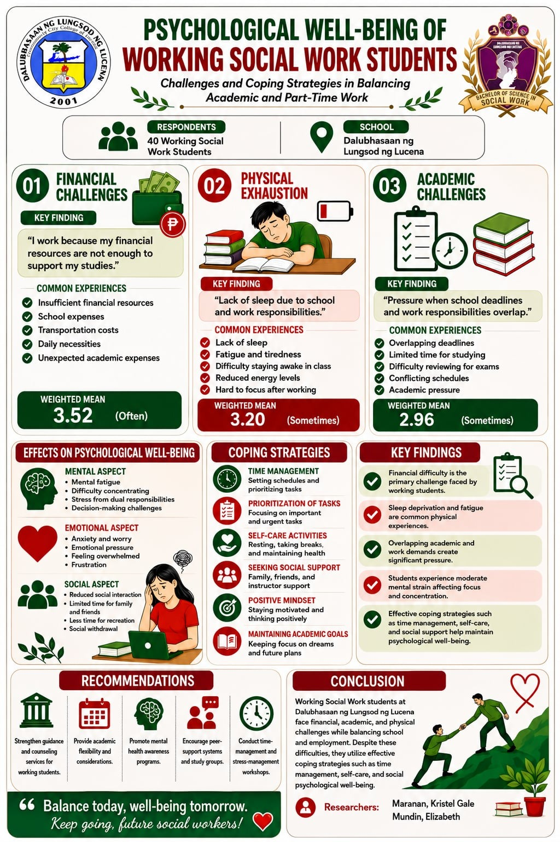
Research Output

Slide 15
THANK YOU

Slide 16
THESIS DEFENDED

